Slide 1


Slide 2
Adding and Editing
Simple
Minimal effort
Notes:
Thank you Riwu and good afternoon everyone. I am Julian, and I will be bringing all of you through the add and edit capabilities of WURI. First off, WURI’s add feature is amazingly simple, built with the sole purpose of allowing users to add tasks with minimal effort. As showing will definitely bring more clarity than seeing, let us jump right into it!
Now, imagine that you want to read some books in your free time, at your own pace. You can simply type “Read books” into WURI for it to be recorded down for you!
Now, lets just say that you are meeting a friend for lunch on this Saturday. Simply type “Meet friend Saturday 12pm” to record it down into WURI.
Tada, isn’t it amazing?
Moving on, how many of us here have work due by the end of almost every week?
For me I often have work due by the midnight of Sunday. If you face a similar situation, no problem! Just type “Do work Sunday 23:59 1w” and WURI will now record this task every week on Sunday. If Sunday has passed and you want to move the deadline to the next weekend, simply type “d 1” to delete last Sunday’s task, bringing it forth to the next week. I will leave Ruomu to discuss the rest of deletion later.
Now imagine if your meeting with your friend got rescheduled to Thursday instead. Simply type “e 1 thurs” and the date will be edited accordingly. Now what if your friend suddenly says that he can only make it for dinner as it is a weekday? Fret not! Type “e 1 7pm” and the new time will be reflected in WURI.
Lastly, imagine that your workload has increased and that you now have work due every 3 days! We totally understand that at this point, you do not have the time to fiddle around with fanciful commands, so we’ve kept it short and sweet. Simply type “e 2 3d” for your deadlines to now be set every 3 days! I will now be passing the time over to Ruomu to talk about the rest of WURI’s capabilities.

Slide 3
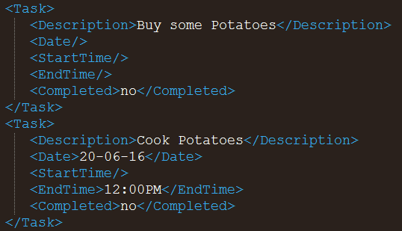
Storage
Extensible Markup Language (XML)
Simple structure
Easy to edit

Slide 4



Storage

Slide 5

What’s next?
Colour scheme
Change Fonts
Mobile App
Notifications
Modular
Encryption
Web App
Scalable
Autocomplete
More

Slide 6

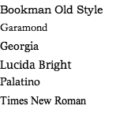
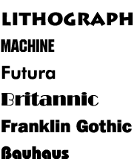
What’s next?
Customizability
Colour scheme
Font

Slide 7

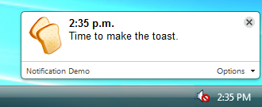




What’s next?
Notifications
Encryption

Slide 8
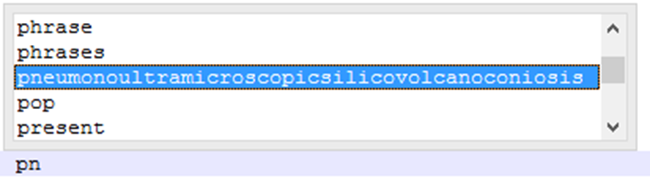
What’s next?
Autocomplete & Autocorrect
Personalized

Slide 9
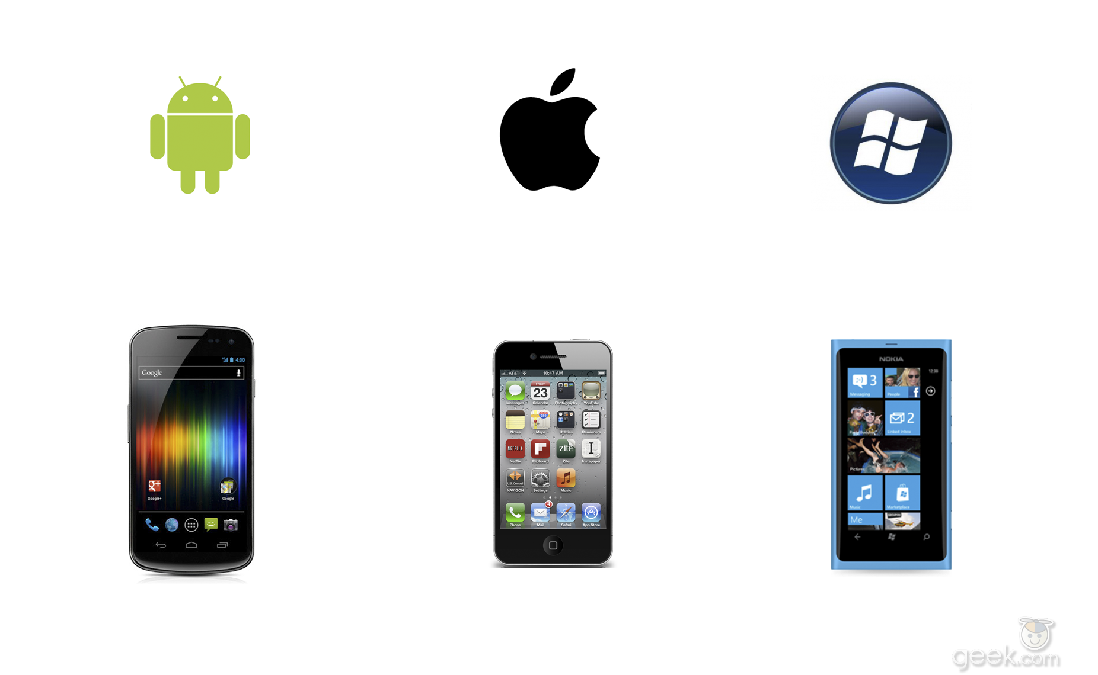

What’s next?
Mobile support
Web Application

Slide 10
Questions?

